Slide 1
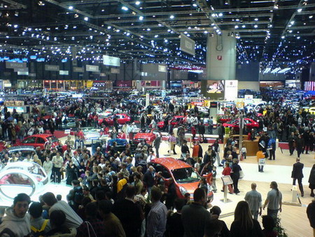
CLEPA Meeting September 29, 2010
Paris Auto Salon 2010
Richard Parry-Jones
Co-Chair -- Automotive Council UK

Slide 2
Purpose
Introduce members to the work of the Automotive Council UK
Reflect on the current state of the UK industry
Highlight the opportunities for the Supplier industry in UK Auto Sector
Provide a case for expanding investment in the UK

Slide 3
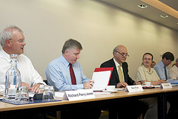
Background
A joint Government and Industry body
Promoting a strategic role for the UK auto industry
Shift in UK Government policy – manufacturing anchor sector in healthy mixed economy
Main role – set the agenda, promote collaboration
Main focus – Low carbon technology, strengthened supply chain

Slide 4
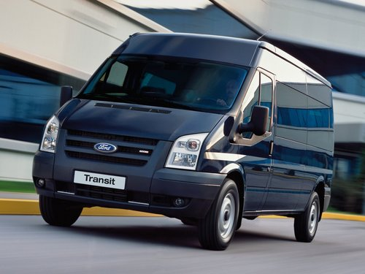
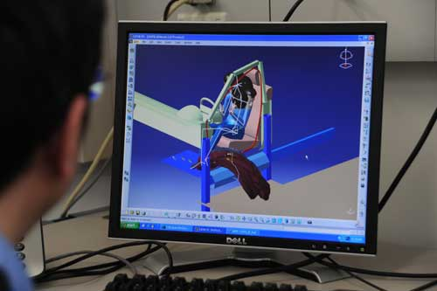
Invest in the UK
Automotive is the UK’s number one manufactured export sector, 77% of output is exported, bringing £21 billion into the UK economy.
Eleven of the world’s volume vehicle manufacturers have a base in the UK, supported by 19 of the world’s top 20 suppliers
The UK is the number one gateway to Europe, with easy access to the 500 million people in 27 EU member states.
Home to some of the best Universities in the world, the UK boasts a workforce of 30 million that is highly trained, qualified and flexible.
Businesses in the UK benefit from access to a strong investment community, positive company and IP law, and excellent industrial relations

Slide 5
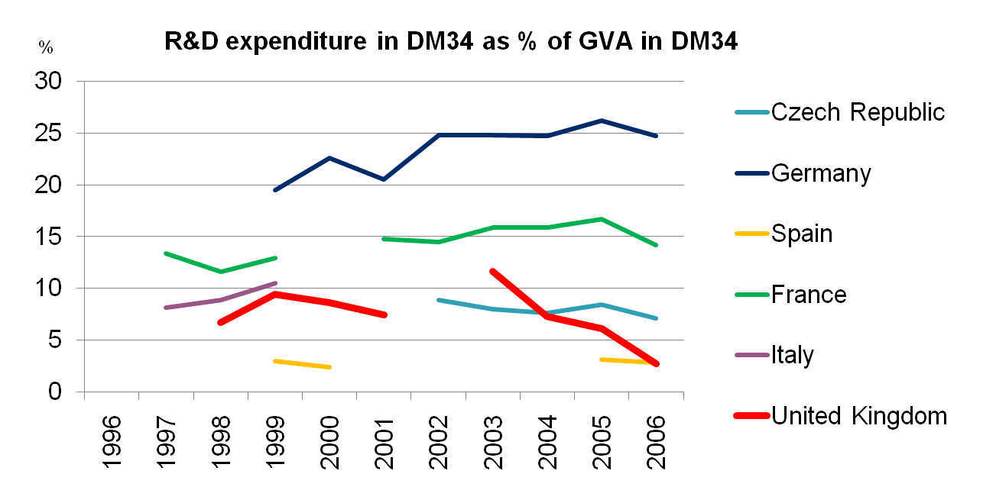
Challenges
Severe and sustained ‘Hollowing out’ trend over 10 years
Reduction of R&D intensity among Supply base
Scale challenges – volume 1.8 m less than half major competitors
Weakened supply base – big issue

Slide 6
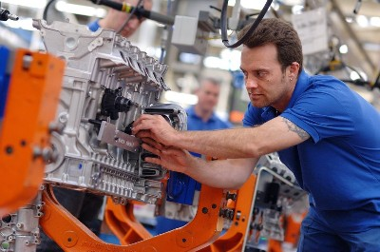
Opportunities
Strong powertrain sector with
competitive scale -- >3 m engines annually
Bridgend
Dagenham
Hams Hall
Deeside
Swindon
Strong Premium and Niche sectors
Jaguar Land Rover
Bentley
Rolls Royce
Aston Martin
Lotus

Slide 7
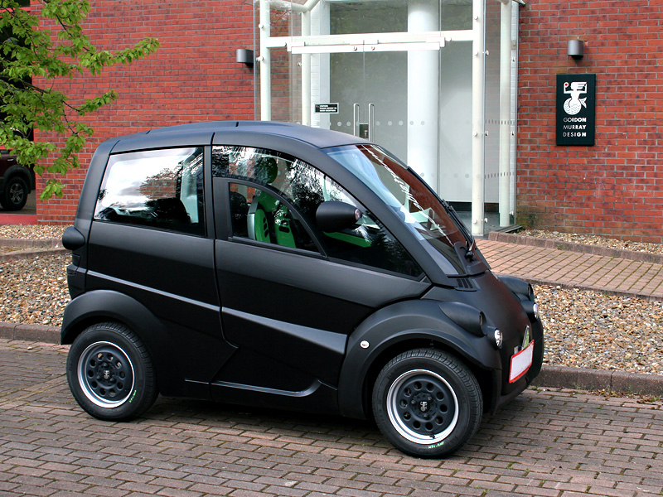
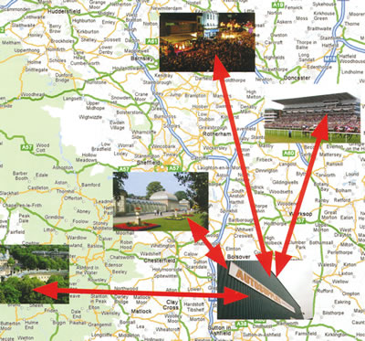
Opportunities
Low Carbon revolution – technology and manufacturing centre
Supply lines stretched – OEM desire for more locally sourced parts

Slide 8
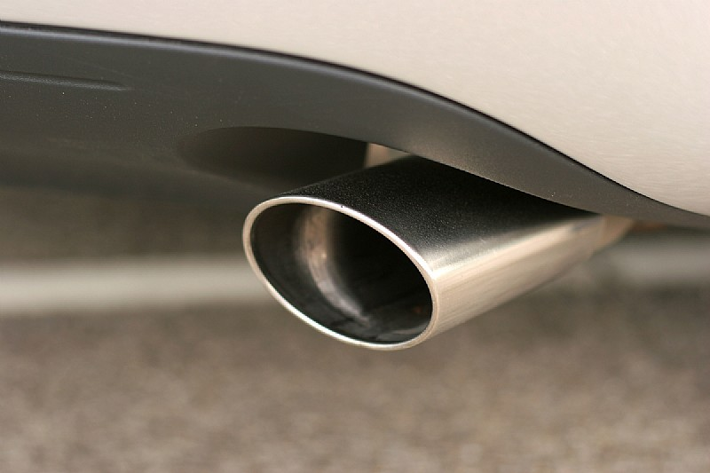
Leading the Low Carbon Revolution
UK manufactured vehicle emissions have dropped 21% since the end of the last decade
London has nearly 2,500 electric vehicles on its streets, more than almost any other city in the world – Oslo is the only city with more, with around 2,650.
One of the our key objectives is to position the UK as a leader in the development and exploitation of low carbon vehicle technologies
We also aim to position the UK as a world leader in the development, demonstration, manufacture and use of ultra-low carbon automotive technology through investment in R&D and market incentives to reward early adopters

Slide 9
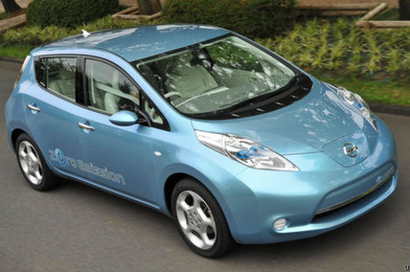
Opportunities
Low Carbon revolution – technology and manufacturing centre

Slide 10
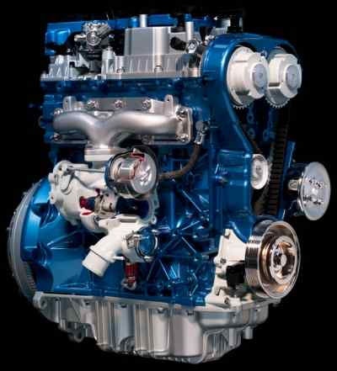
Investors deepen their UK base:
2010 Announcements
Ford – announced £1.5 Bn investment in UK, two thirds of workforce in R&D
Jaguar Land Rover expansion and R&D recruitment
Nissan – sourced Nissan Leaf in UK --invests £179m
Toyota announces Auris Hybrid production in UK

Slide 11
Strategic Approach
Positive and supportive
business environment
Consistent, aligned positive
messages
Education and skills for STEM
and Manufacturing
Simplify support mechanisms
Stable, sustainable economy
Tax reforms to more strongly
encourage business in the UK

Slide 12
Strategic Approach
Creation of a UK Automotive Council providing framework for collaboration, in partnership with Government to improve the UK investment offer
Attractiveness – fiscal regime, skills development, R&D support, and pioneering emerging LCV markets
Certainty – long term framework planning, stability,
Credibility – reliability, consistency, dependable support
Partnership and Collaboration

Slide 13
Mission
To promote industrial and Government collaboration to drive a competitive, growing and dynamic automotive industry:
That makes a large and increasing contribution to
employment and prosperity in the UK, and
Plays a decisive global role in developing exciting,
low carbon vehicle transportation solutions
and one that therefore provides investors with attractive and sustainable returns

Slide 14
Membership
Large OEMs
SME niche manufacturers
Construction equipment manufacturers
Tier 1 Suppliers
Infrastructure Companies
DfT
BIS

Slide 15
Automotive Council priorities
Promote completed industry consensed Technology Roadmap and within that, secure R&D investment in the highest priority technologies
Develop Commodity Roadmap based on prioritised sourcing opportunities for the UK to leverage collaborative scale. Strengthen and support candidate suppliers if required
Develop communications plan to promote positive image for industry among stakeholder groups

Slide 16
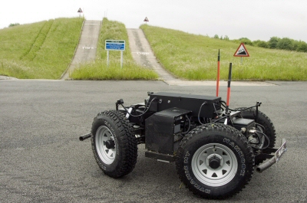
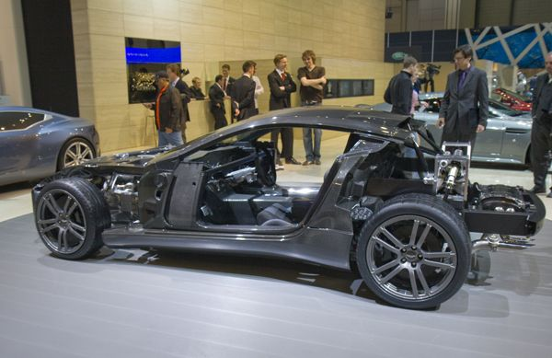
Technology Activities
Technology Roadmap
Industry-consensed, regularly updated
Focus technologies
High technology ICE engines
Energy Storage and Management
Lightweight structures
Low cost power electronics
Intelligent Transportation systems

Slide 17
Commodity Sourcing Roadmap
ISSUE:
OEMs want to source more to the UK
They can’t place the business presently because of technology, engineering, management, cost competitiveness issues
PLAN:
Identify the most promising commodities to source in the UK and select top priority commodity list
Identify and address inhibitors specific to these commodities

Slide 18
Recent achievements
New Coalition Government achieved smooth transition with full alignment -- financial support for key automotive investments confirmed
UK becoming EV/Hybrid European Production hub with Nissan Leaf and Toyota Auris announcements --Vauxhall Ampera potential
TSB Call based on FocusTechnology priorities well supported
OEM Sourcing survey completed and Supplier survey nearing completion
New model program decisions being taken this year!– positive sourcing outcomes
Strategic communications activities including website and e-news letter launched check out http://www.automotivecouncil.co.uk/

Slide 19
Thank you
http://www.automotivecouncil.co.uk/

